Slide 1
Digits Translator App
Ng Jun Kang

Slide 2
Problem Statement
To build an App for digit translation (digit 0 to 9) from speech to text. Envisaged to enhance the App for waypoint translation in the future
Translation to be able to function in environments with and without noise

Slide 3
System Overview
App in Amazon Web Service
User Terminal
Flask in Docker Server
Machine Learning Model
Web Browser
Recording Device
Audio Clip Conditioning
Deep Learning Model

Slide 4
Data Collection
10 sets of Digit of 0, 1, 2, …, 9 without noise (100 sub-total)
10 sets super-imposed with some simulated noise
Another 10 sets super-imposed with more simulated noise (300 in total)

Slide 5
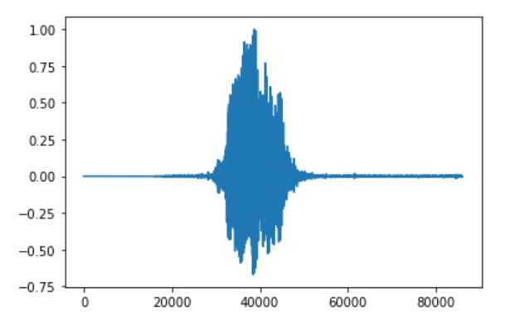
EDA – Without noise

Slide 6
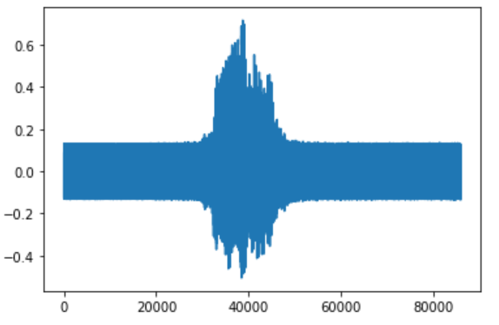
EDA – With some simulated noise

Slide 7
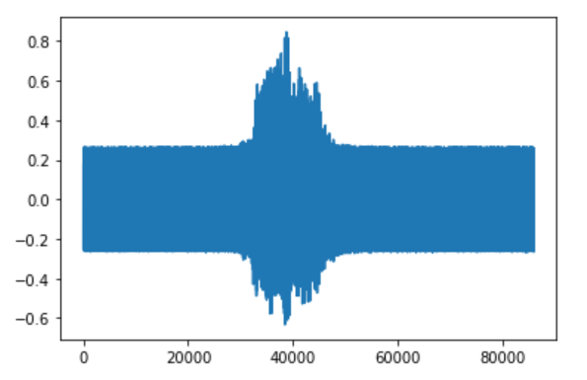
EDA – With more simulated noise

Slide 8
Machine Learning Modelling Process
Feature Extraction (33)
Time-domain (17 features): Absolute Mean, Standard Deviation, Skewness, Kurtosis, Energy Root Mean Square Value, 12 Linear Predictive Coefficients
Frequency-domain (16 features): Spectral Flatness, Zero Crossing Rate, Spectral Centroid, 13 Mel-frequency Cepstral Coefficients
Scaling & Principal Component Analysis

Slide 9
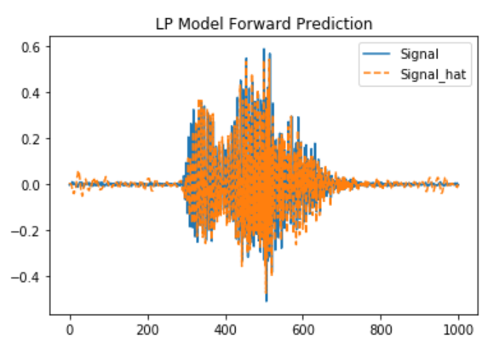
Feature Extraction - LPC

Slide 10
Machine Learning Models
AdaBoost
Cross Validation: 0.71
Train Score: 0.95
Test Score: 0.8
Random Forest Classifier
Cross Validation: 0.91
Train Score: 1.0
Test Score: 0.95

Slide 11
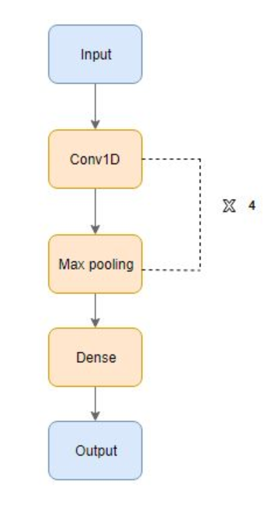
Deep Learning Model
Model Architecture
4 x (1D Convolution, Max Pool and Dropout) Layers
Flatten Layer
2 x Dense Layer
Model Accuracy: 0.95
Source: https://www.analyticsvidhya.com/blog/2019/07/learn-build-first-speech-to-text-model-python/

Slide 12
Current Limitations
1 audio file per request
Recording of up to 15 seconds
Waypoint of 10 digits (0 to 9). English words (e.g. decimal or dot) not supported yet.
Any codec supported by `soundfile` or `audioread` is supposed to work. Tested wav format.
Stereo or Mono channel(s), RFC and CNN trained on mono channel.
Around 1 second duration per digit

Slide 13
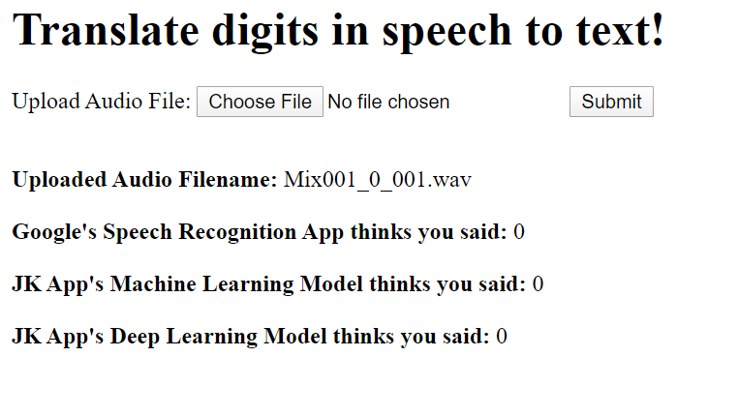
AWS Deployment
Url: http://34.220.201.66:5000/digits

Slide 14
Demo

